Slide 1

Communication Systems
Lab 1
Doat Matthieu
Ferreras Alloin Pablo
Carbonnelle Gautier

Slide 2
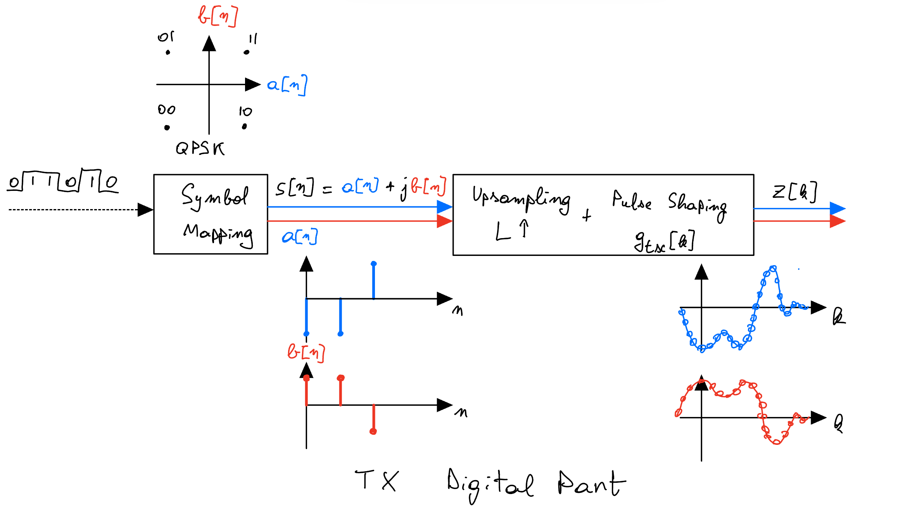
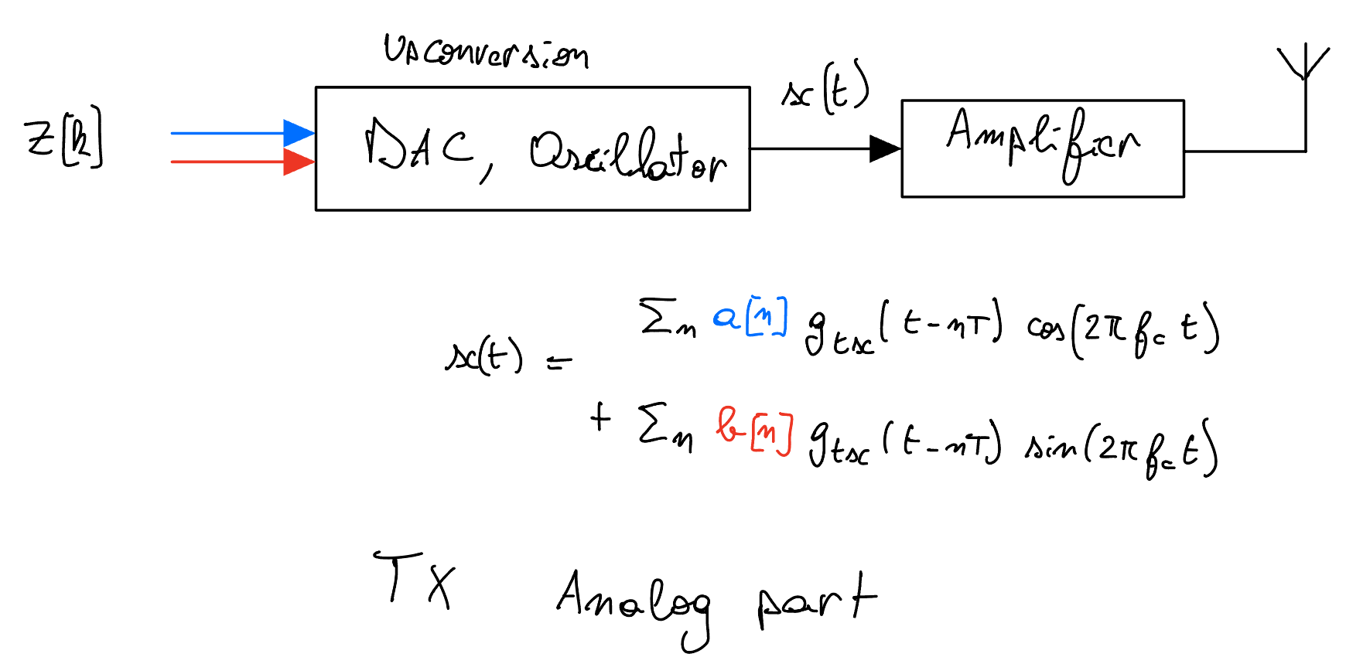
Transmitter Side (TX)

Slide 3
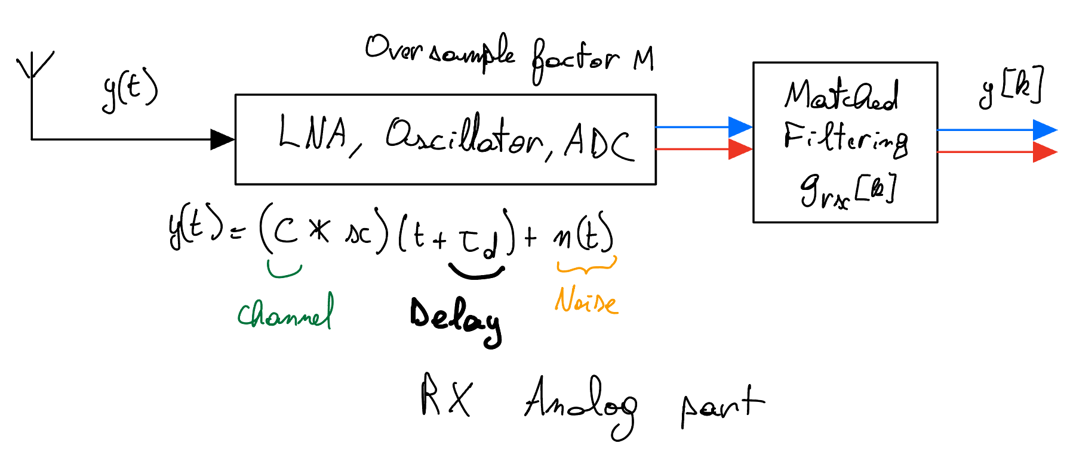
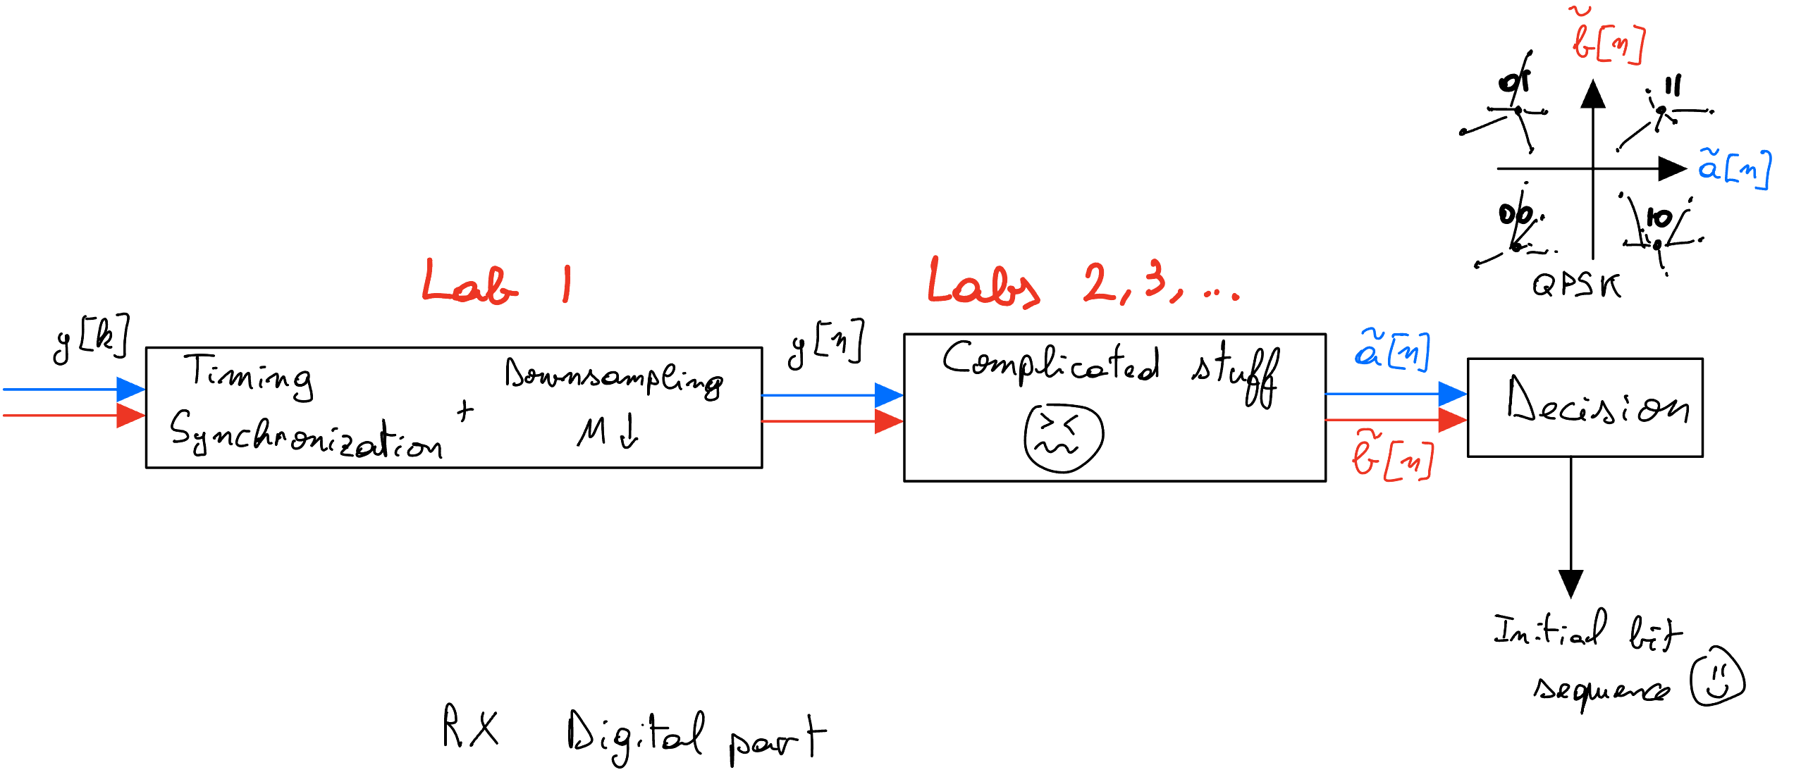
Receiver Side (RX)

Slide 4
Impact of delay on Constellation

Slide 5
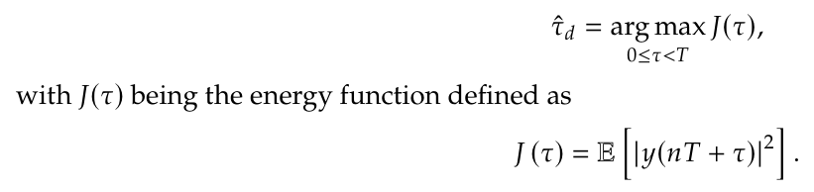
Impact of delay on Eye Diagram

Slide 6
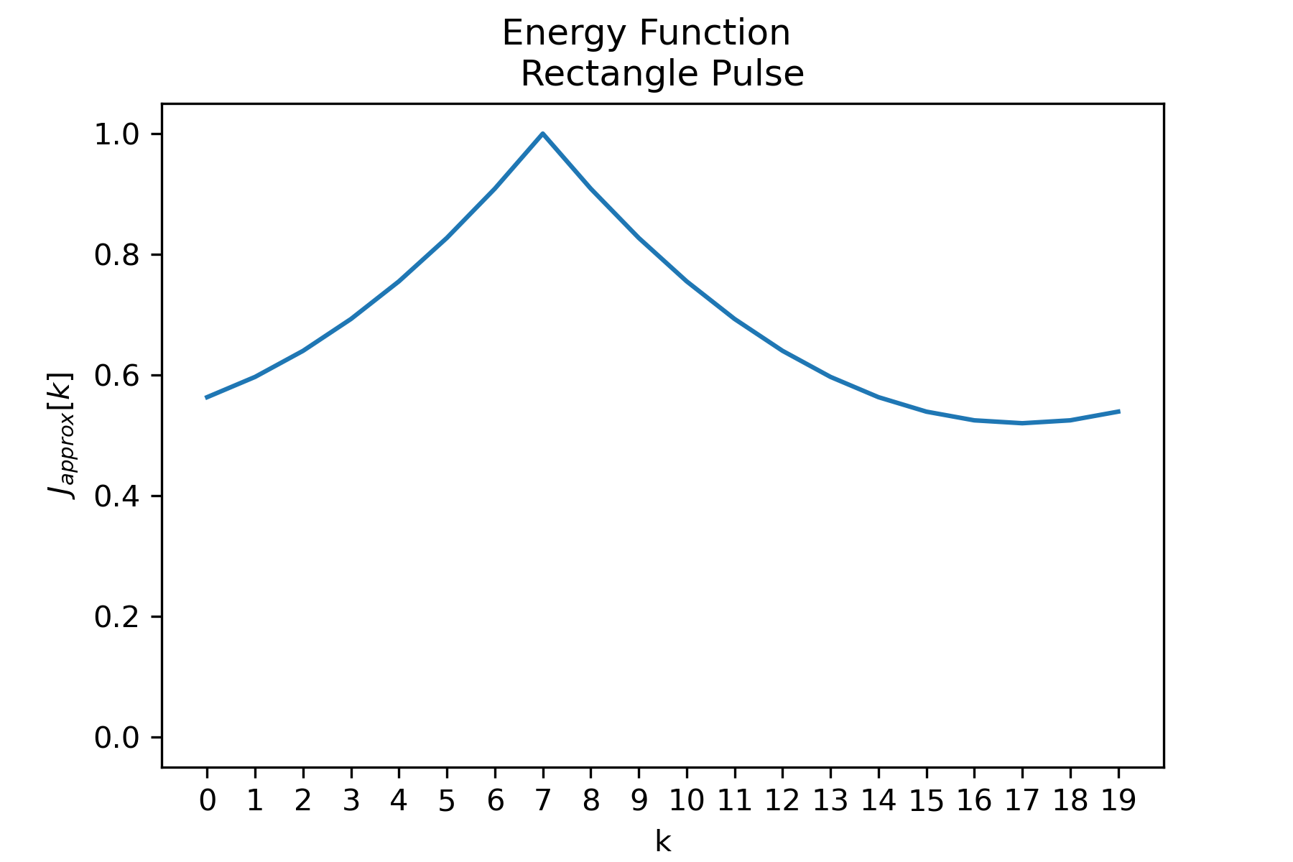



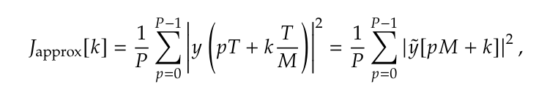
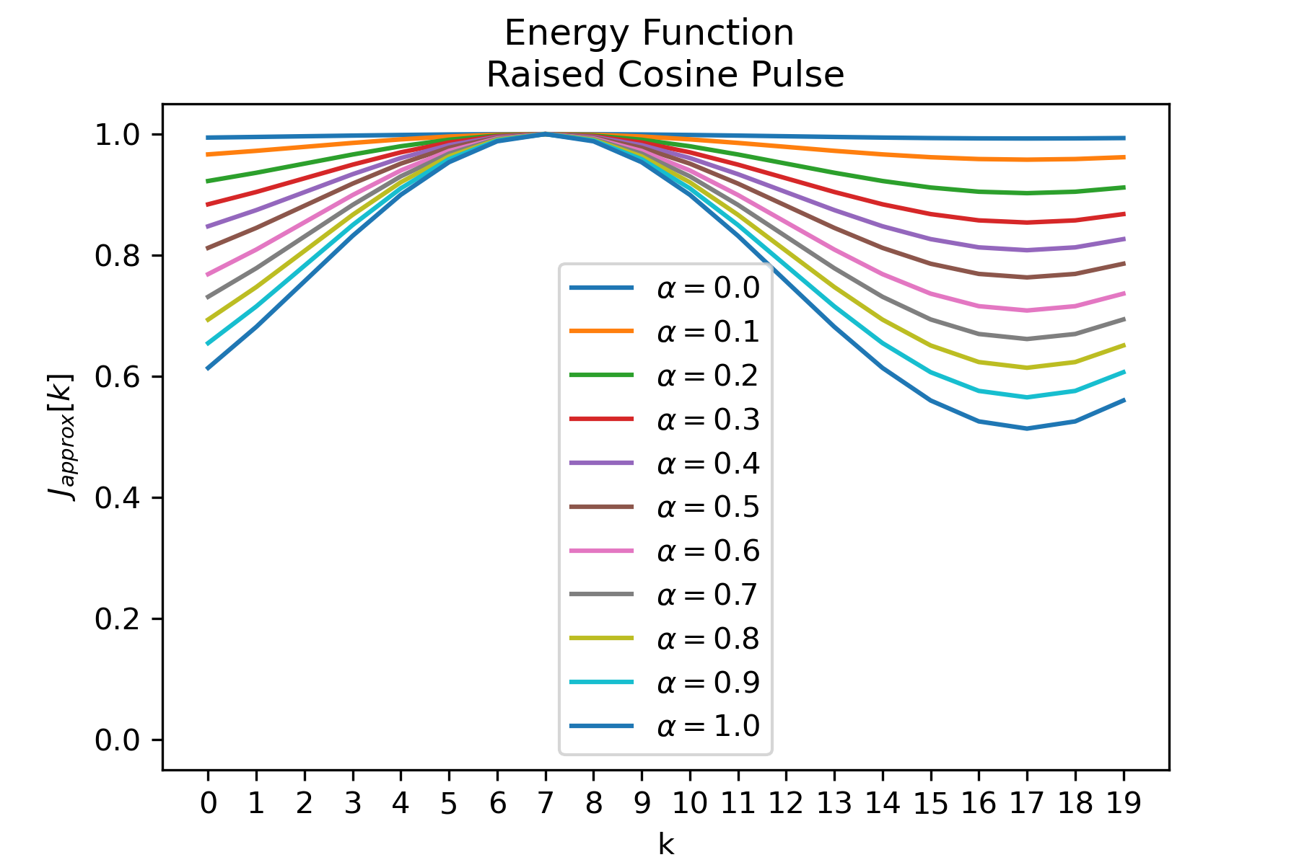
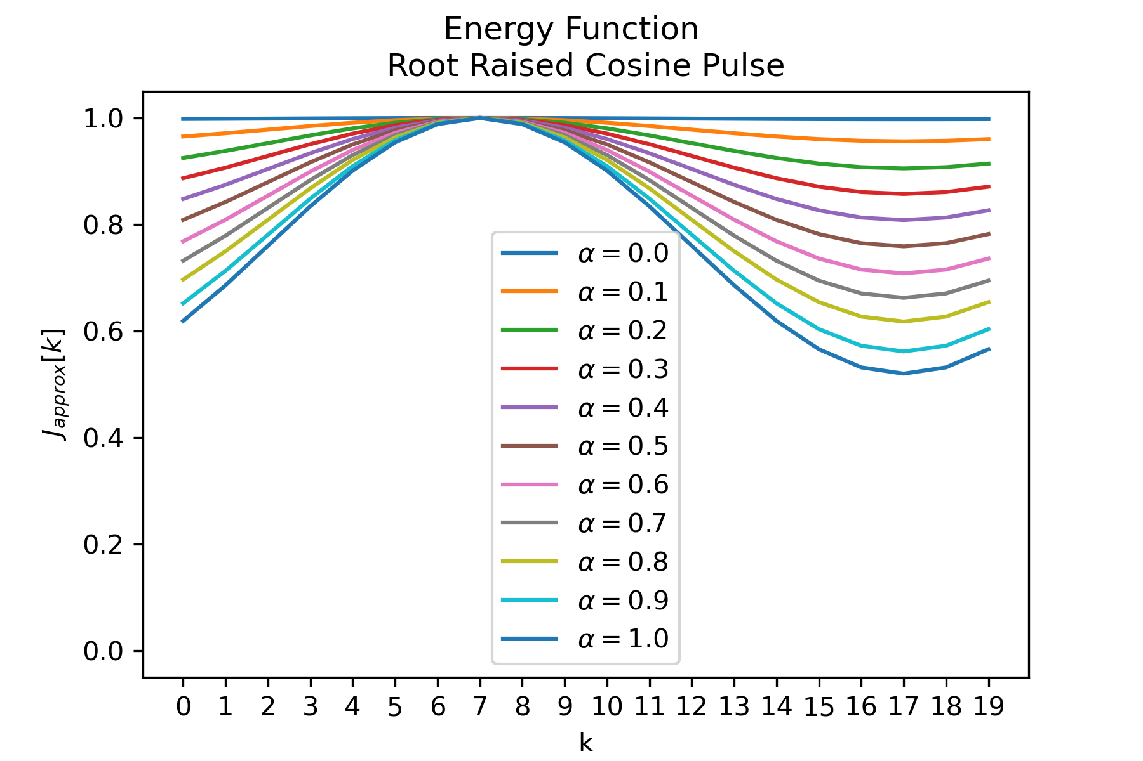


Slide 7
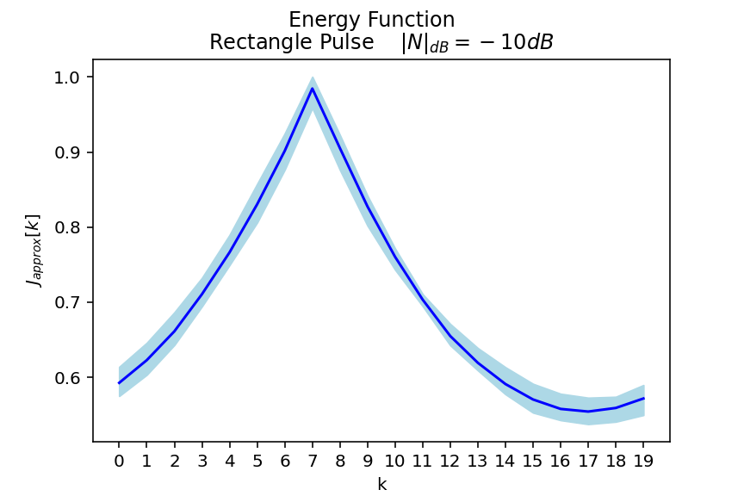
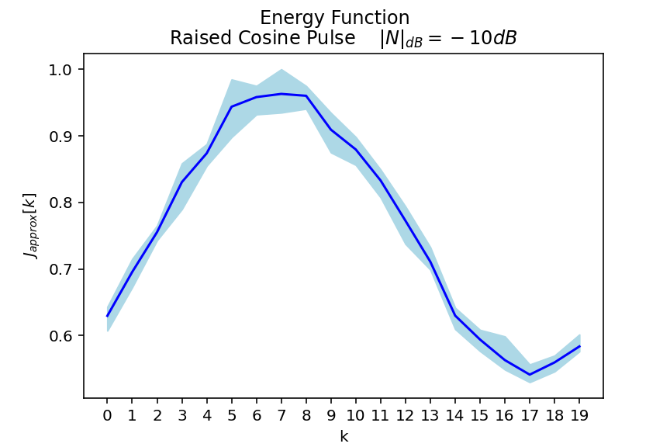
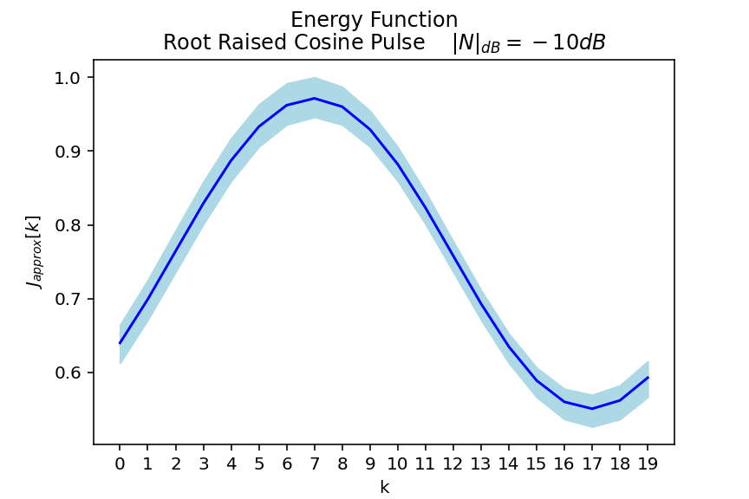
Impact of Noise on Energy Function
Noise Power: -10dB
Matched recpetption filter
No matched reception filter

Slide 8
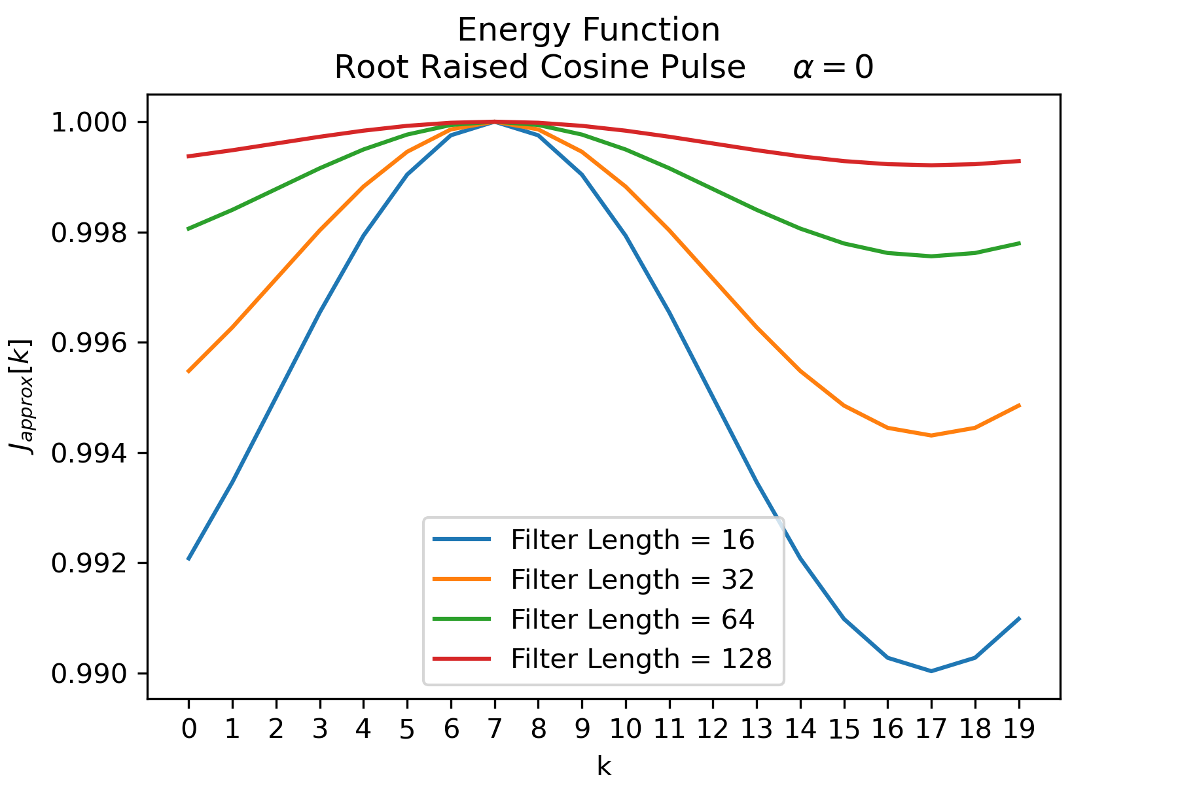
Limitations of Discrete Energy Function

Slide 9
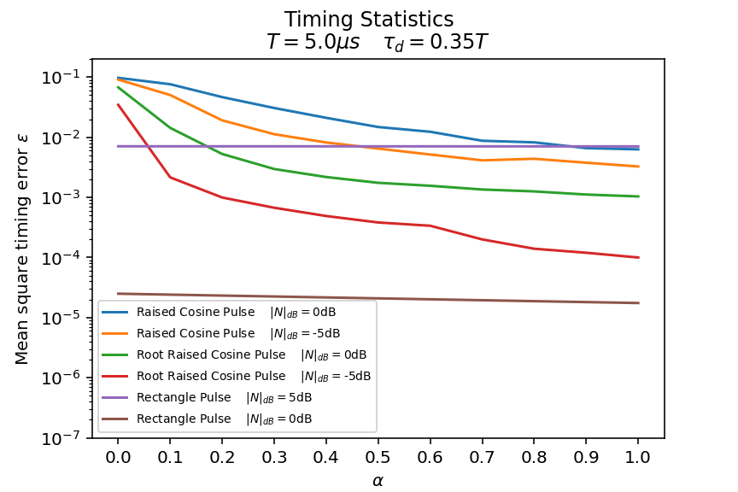
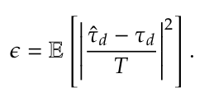
Timing statistics
vs alpha

Slide 10
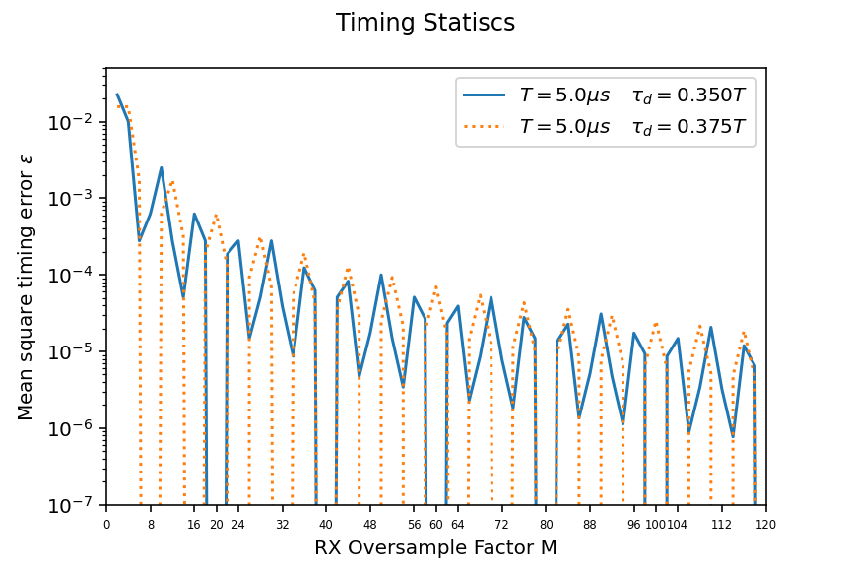
Timing statistics
vs alpha

Slide 11
Channel characterisation, estimation and equalisation

Slide 12
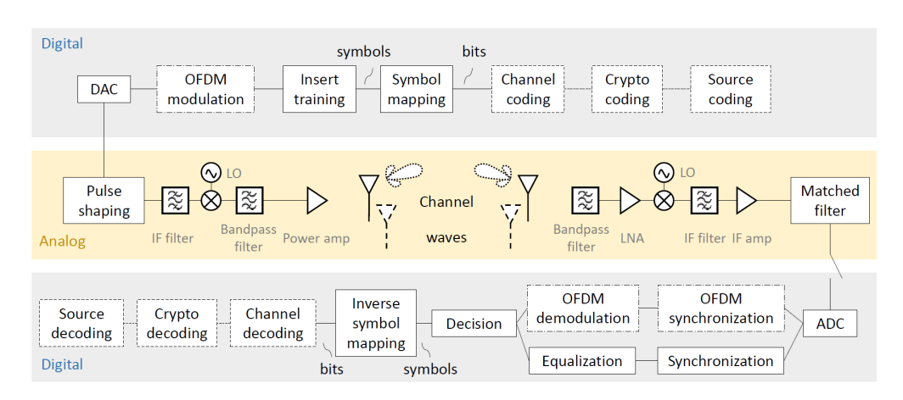
Full chain

Slide 13

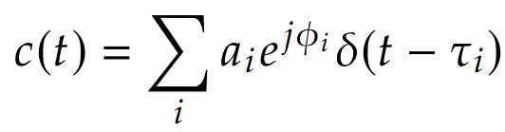
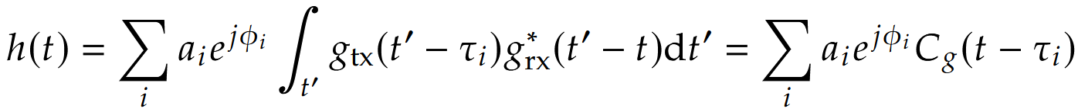
Flat and frequency selective channel
Flat:
Frequency selective:

Slide 14
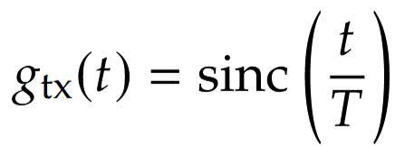


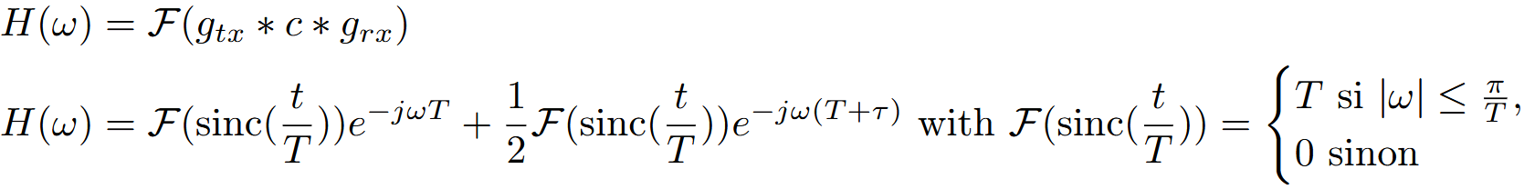
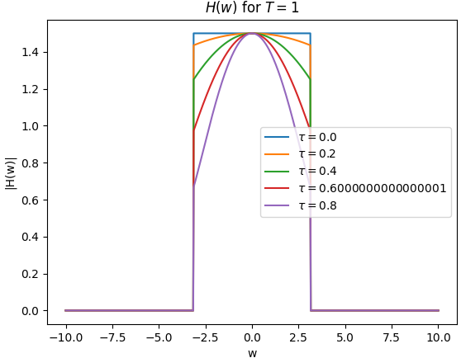
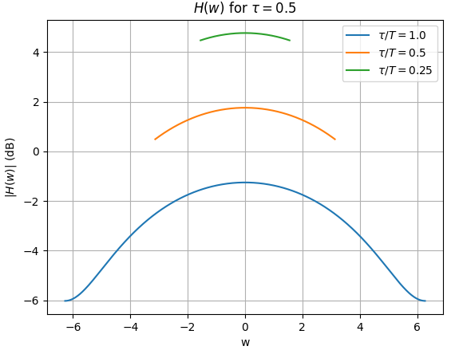
Two path channel

Slide 15
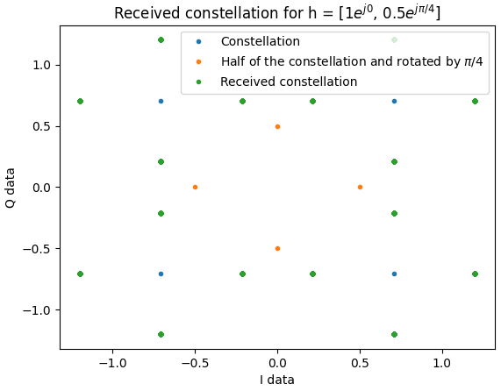
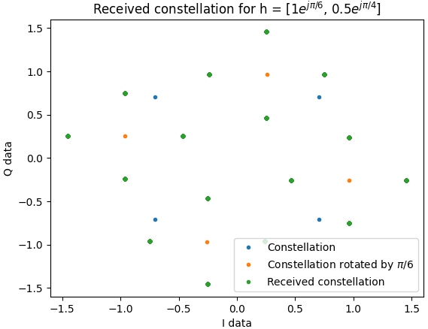
Impact on the received constellation

Slide 16
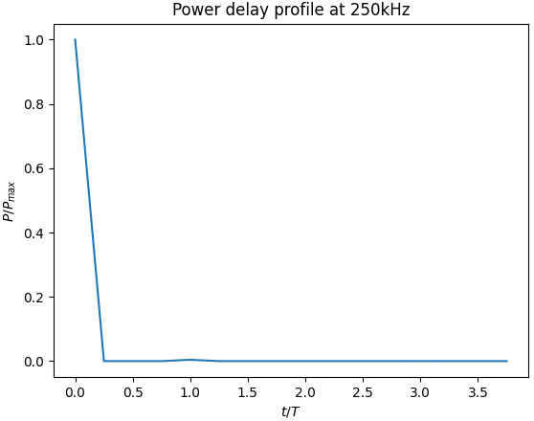
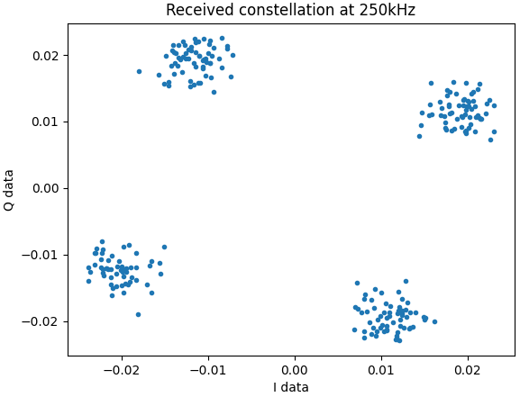
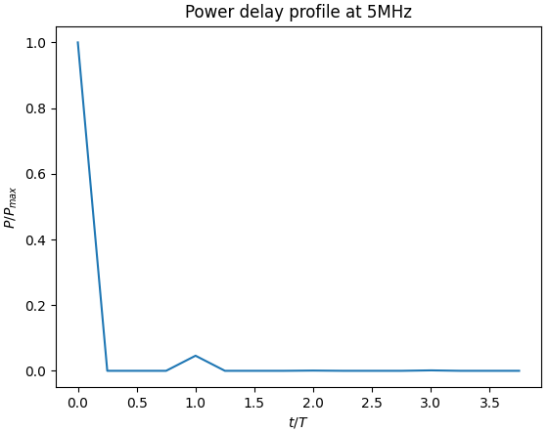
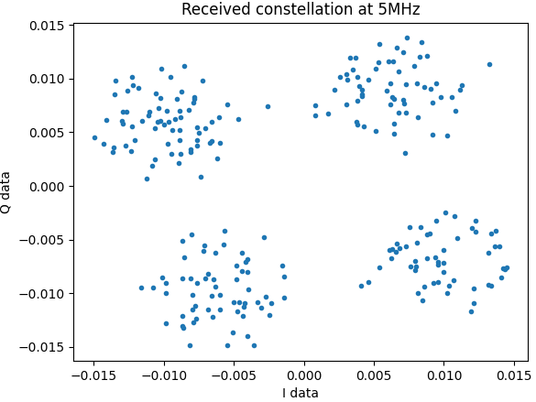
Real channel using the USRPs
At 250kHz, the channel
is frequency flat
At 5MHz, the channel
is frequency selective

Slide 17




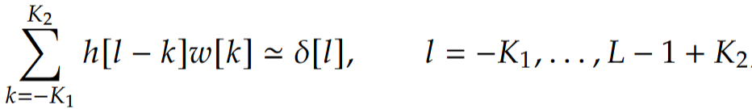
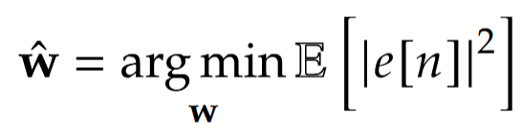
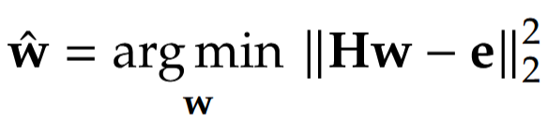
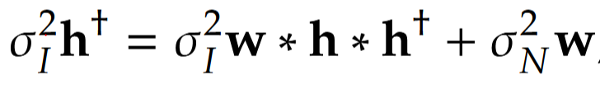

Wiener and Zero-forcing equaliser
Wiener:
Zero forcing:
If the noise is close to -∞, the SNR is close to ∞, the above expression tends to:
⬄

Slide 18
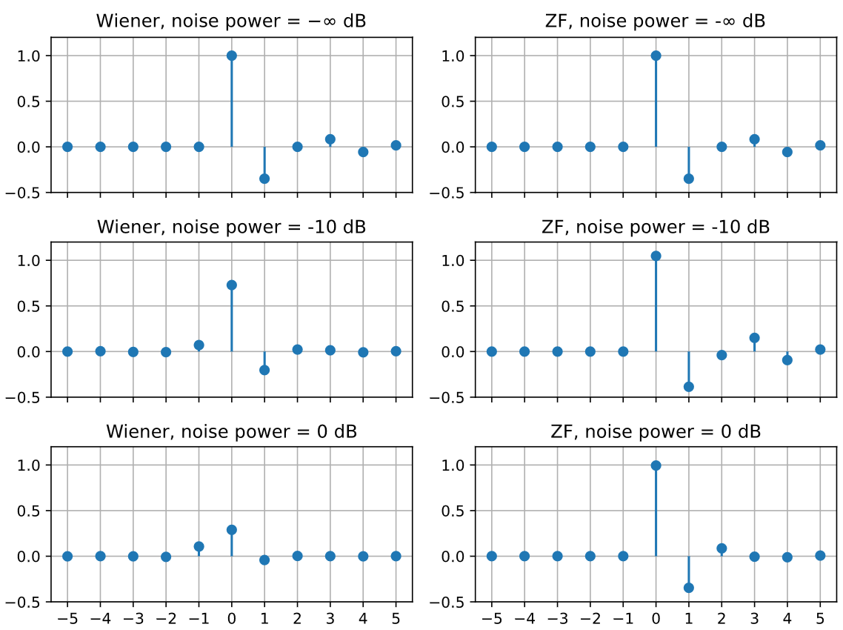
Coefficients comparaison
The channel h = [1 0.35+0.35j]

Slide 19
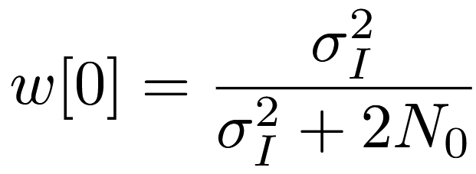
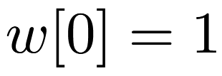
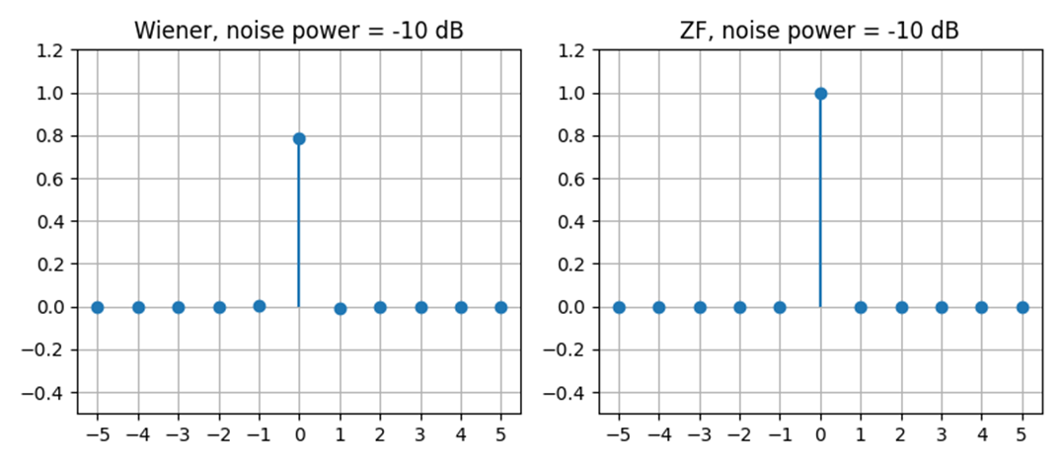
When the channel is AWGN
Wiener:
Zero-forcing:

Slide 20
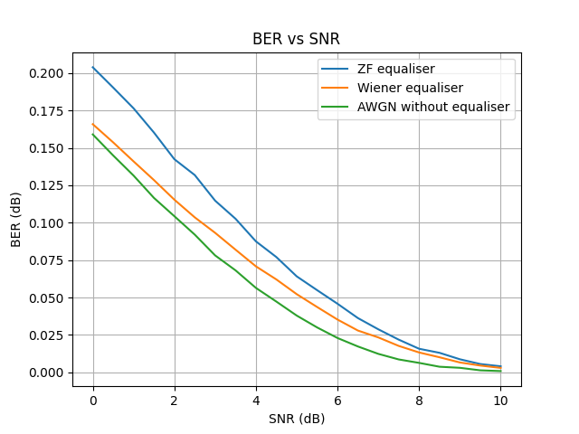
BER comparison
The channel h = [1 0.35+0.35j]
for ZF and Wiener

Slide 21
LELEC2795- Communication systems
Carbonnelle Gautier
Doat Matthieu
Ferreras Alloin Pablo
Lab 3 – OFDM Modulation and Frequency Domain Equalization

Slide 22
Full chain

Slide 23
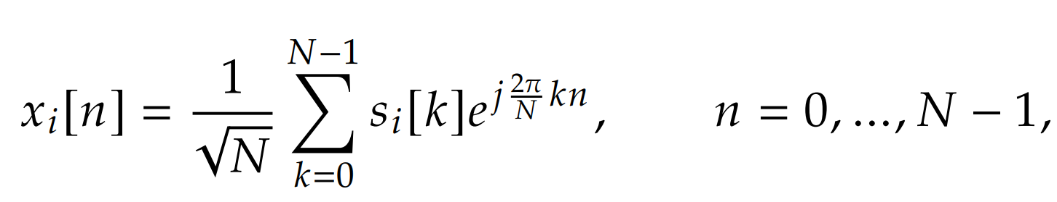
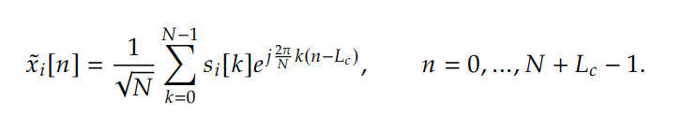
Reminder:
For a given block i (OFDM symbol) and with N subcarriers, we have :
With the cyclic prefix of length L_c, we have
L_c must be longer than the number N of channel taps
Period = NT
Notes:
We will see later why L_c bigger

Slide 24
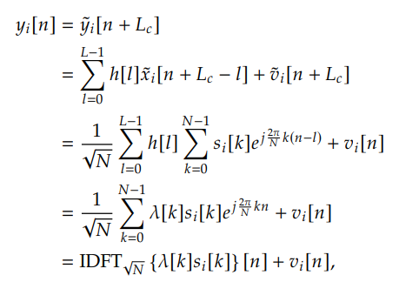
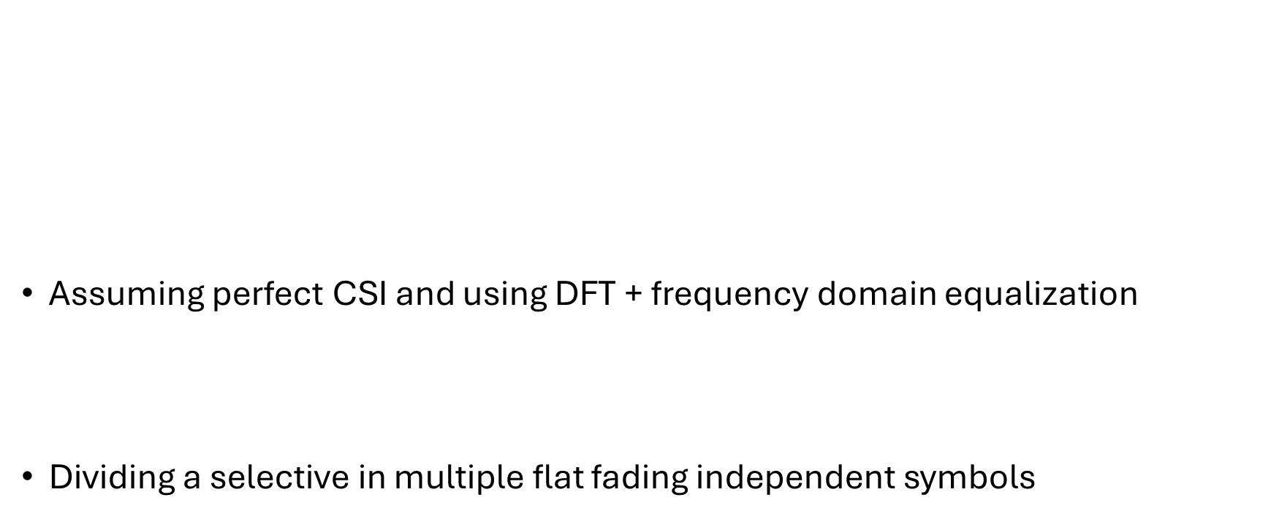
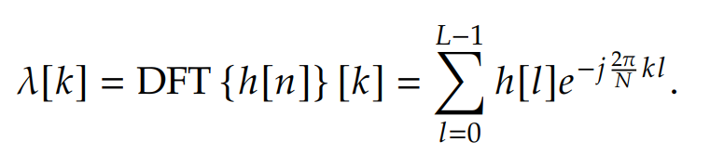
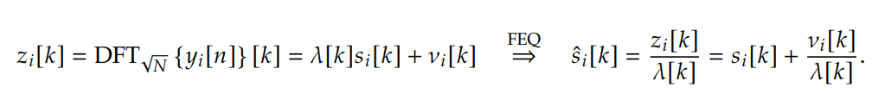
Demodulation
Notes:
Assumption that L_C bigger than L – 1 because if not we would have negative index in the sum, that would lead to taps of previous symbols being annoying.

Slide 25
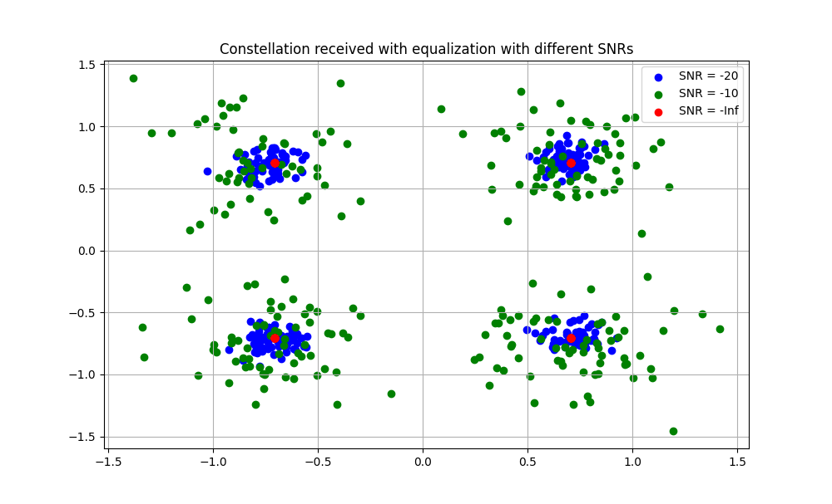
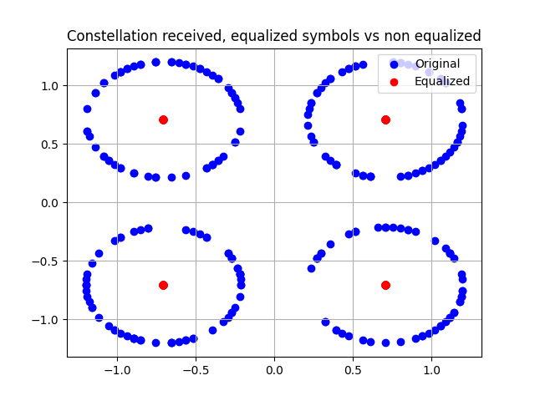
Simulation
Channel response : [1, 0.35 + 0.35i]
Estimated response :
[0.999 - 3.9E-16i, 0.349 + 0.349i, -5.7E-16 + 2.1E-15i]

Slide 26
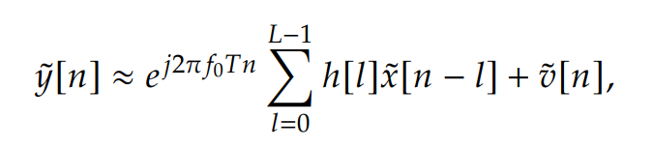

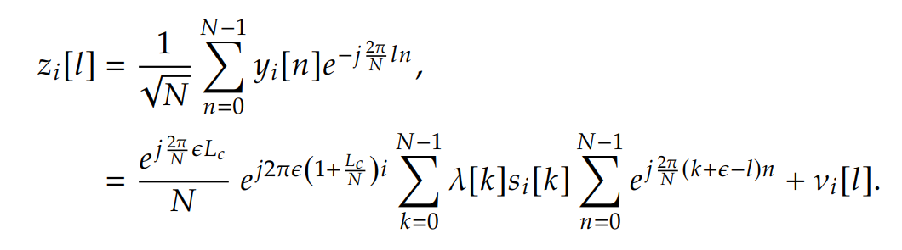
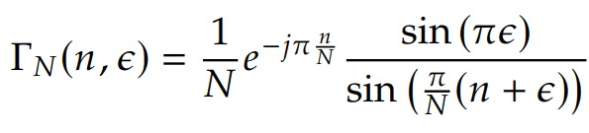
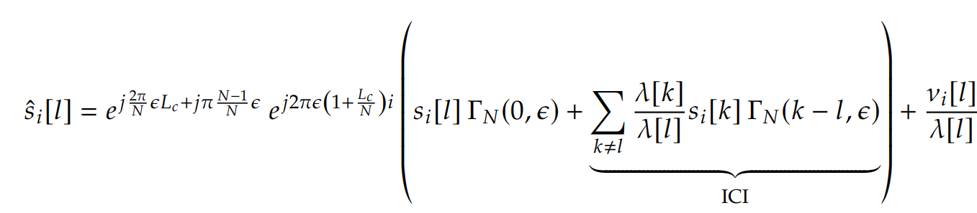


Frequency Offset
Whole constellation rotation
Rotation for each symbol
Notes:
Quand \epsilon = 1, on a sin (pi/N (n+e)) qui va va valoir 0 en n = N - 1

Slide 27

Inter carrier interference
=> Our ‘true’ symbol will be attenuated and the nearby symbols will have an impact

Slide 28


Simulation

Slide 29


BER vs frequency offset

Slide 30

Bit-rate
For a QAM modulation :
K = number of unused subcarriers (null tones)
=>because of RF distortion at DC or interferences at the edge of the BW
Notes:
OFDM transforme selective en flat donc est plus facile pour l’égalisation

